Slide 1
Real-time Health Care Analytics
Preeti Billa
Thanuj kumar Janugani
Mounica Reddy kandi
Varun Teja Maguluri
Project Advisor Weider Yu

Slide 2
Introduction
The main goal of this project is to develop a data-driven solution for predicting heart problems in individuals with the aim of improving the accuracy and efficiency of health prediction.
The existing healthcare system relies heavily on the expertise of healthcare professionals, which can be limited by available information and extensive experience.
To overcome these limitations,the project will use data mining techniques and algorithms.
The dataset contains various attributes such as age, gender, type of chest pain, cholesterol, sugar, and score that can be used to train the system and predict heart problems.

Slide 3
Significance
The significance of this project is that it has the potential to transform the healthcare industry by reducing reliance on medical professionals and providing more accurate and efficient health predictions.
The system can detect potential health problems early, so individuals can take proactive steps to improve their health and reduce their risk of heart disease.

Slide 4
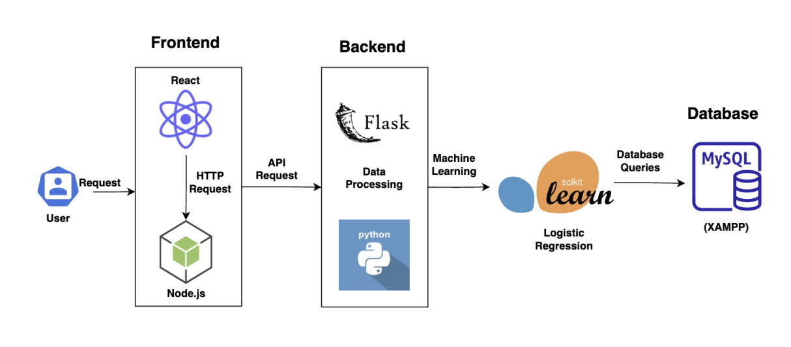
Project Architecture
Notes:
This is our project Architecture where we incorporated full stack development with machine learning, where we used react and Node for frontend, flask for backend, mysql database and logistic regression for machine learning. Our project has persona that includes user modules, heart health modules and profile update modules, all of which will be showcased in our demo.

Slide 5
Thank you

